Slide 1
IS-456: Database Management Systems
Module 4: Application Development and Database Joins
Summer 2022
CityU
of Seattle

Slide 2
Topics
SQL Joins Definition
Different types of Joins
Clause Options (ORDER BY, WHERE)
Logical Operators
Summary
References
CityU
of Seattle

Slide 3
SQL JOINS & Types
Definition: is a method to relate and retrieve data from two or more tables
Types of Joins:
MAJOR JOINS
Inner Join (Simple Join)
Left Outer Join (LEFT JOIN)
Right Outer Join (RIGHT JOIN)
Full Outer Join ( FULL JOIN)
OTHER JOINS
Natural Join
Cross Join
Recursive Joins

Slide 4
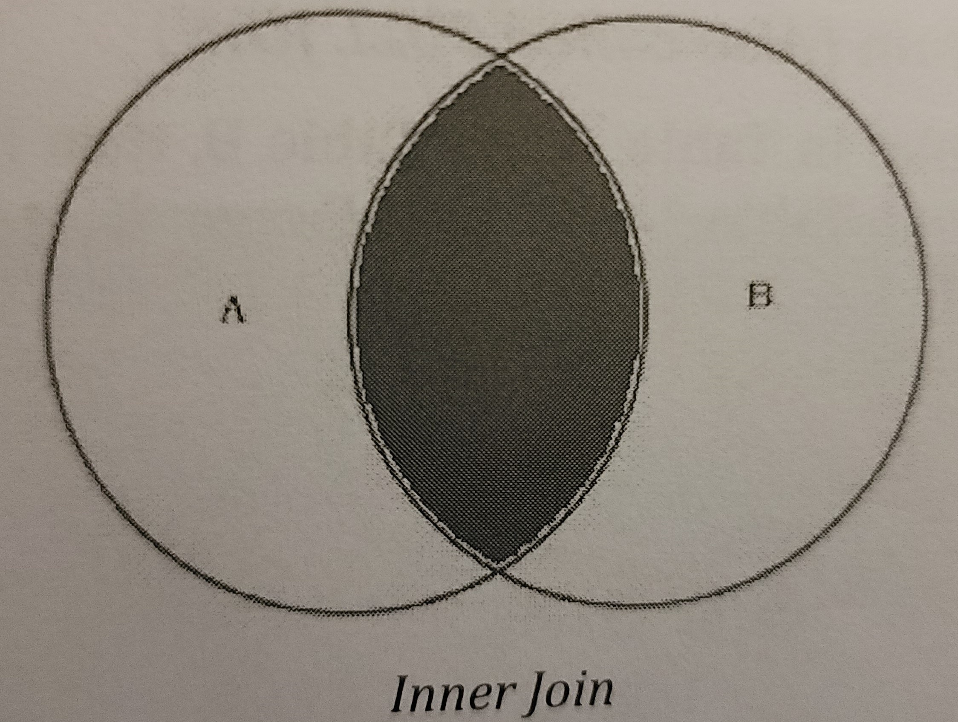
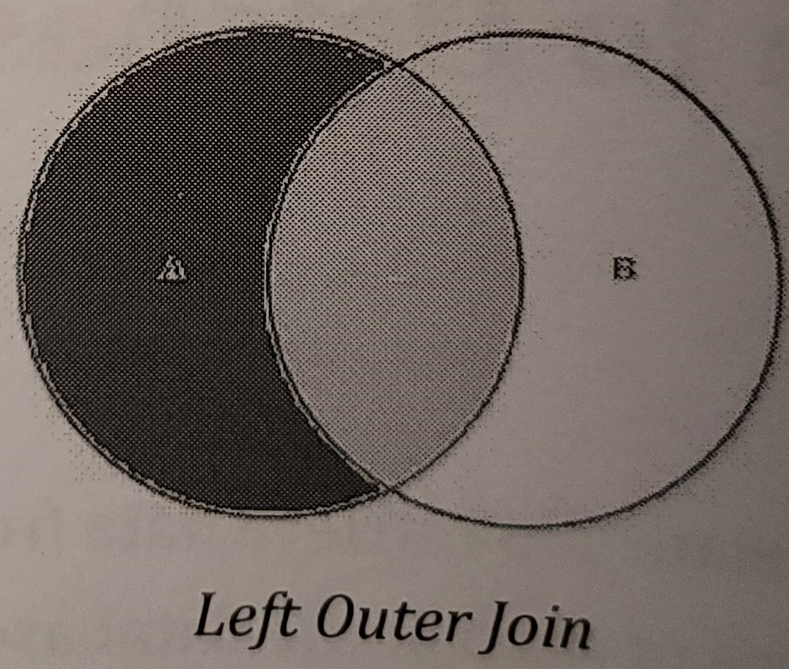
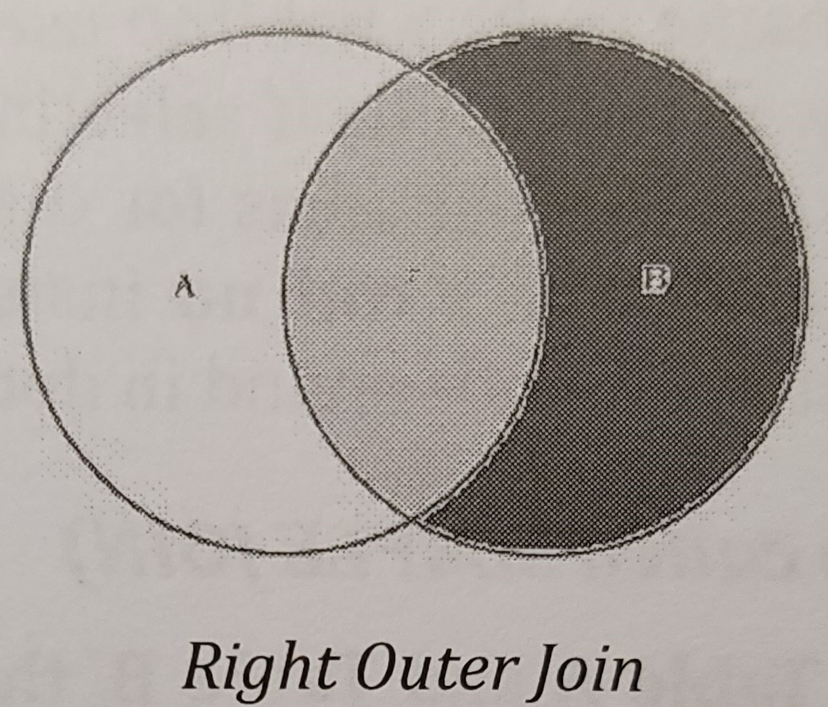

INNER JOIN
LEFT JOIN
RIGHT JOIN
FULL JOIN

Slide 5
JOINS Continue
Natural Join: returns all rows with matching values in the matching columns and eliminates duplicate columns.
Syntax: SELECT column-list FROM table1 NATURAL JOIN table2
Cross Join: performs a relational product (known as cartesian product) of two tables
Syntax: SELECT column-list FROM table 1 CROSS JOIN table2
Recursive Join: A table alias is especially useful when a table must be joined to itself in a recursive query

Slide 6
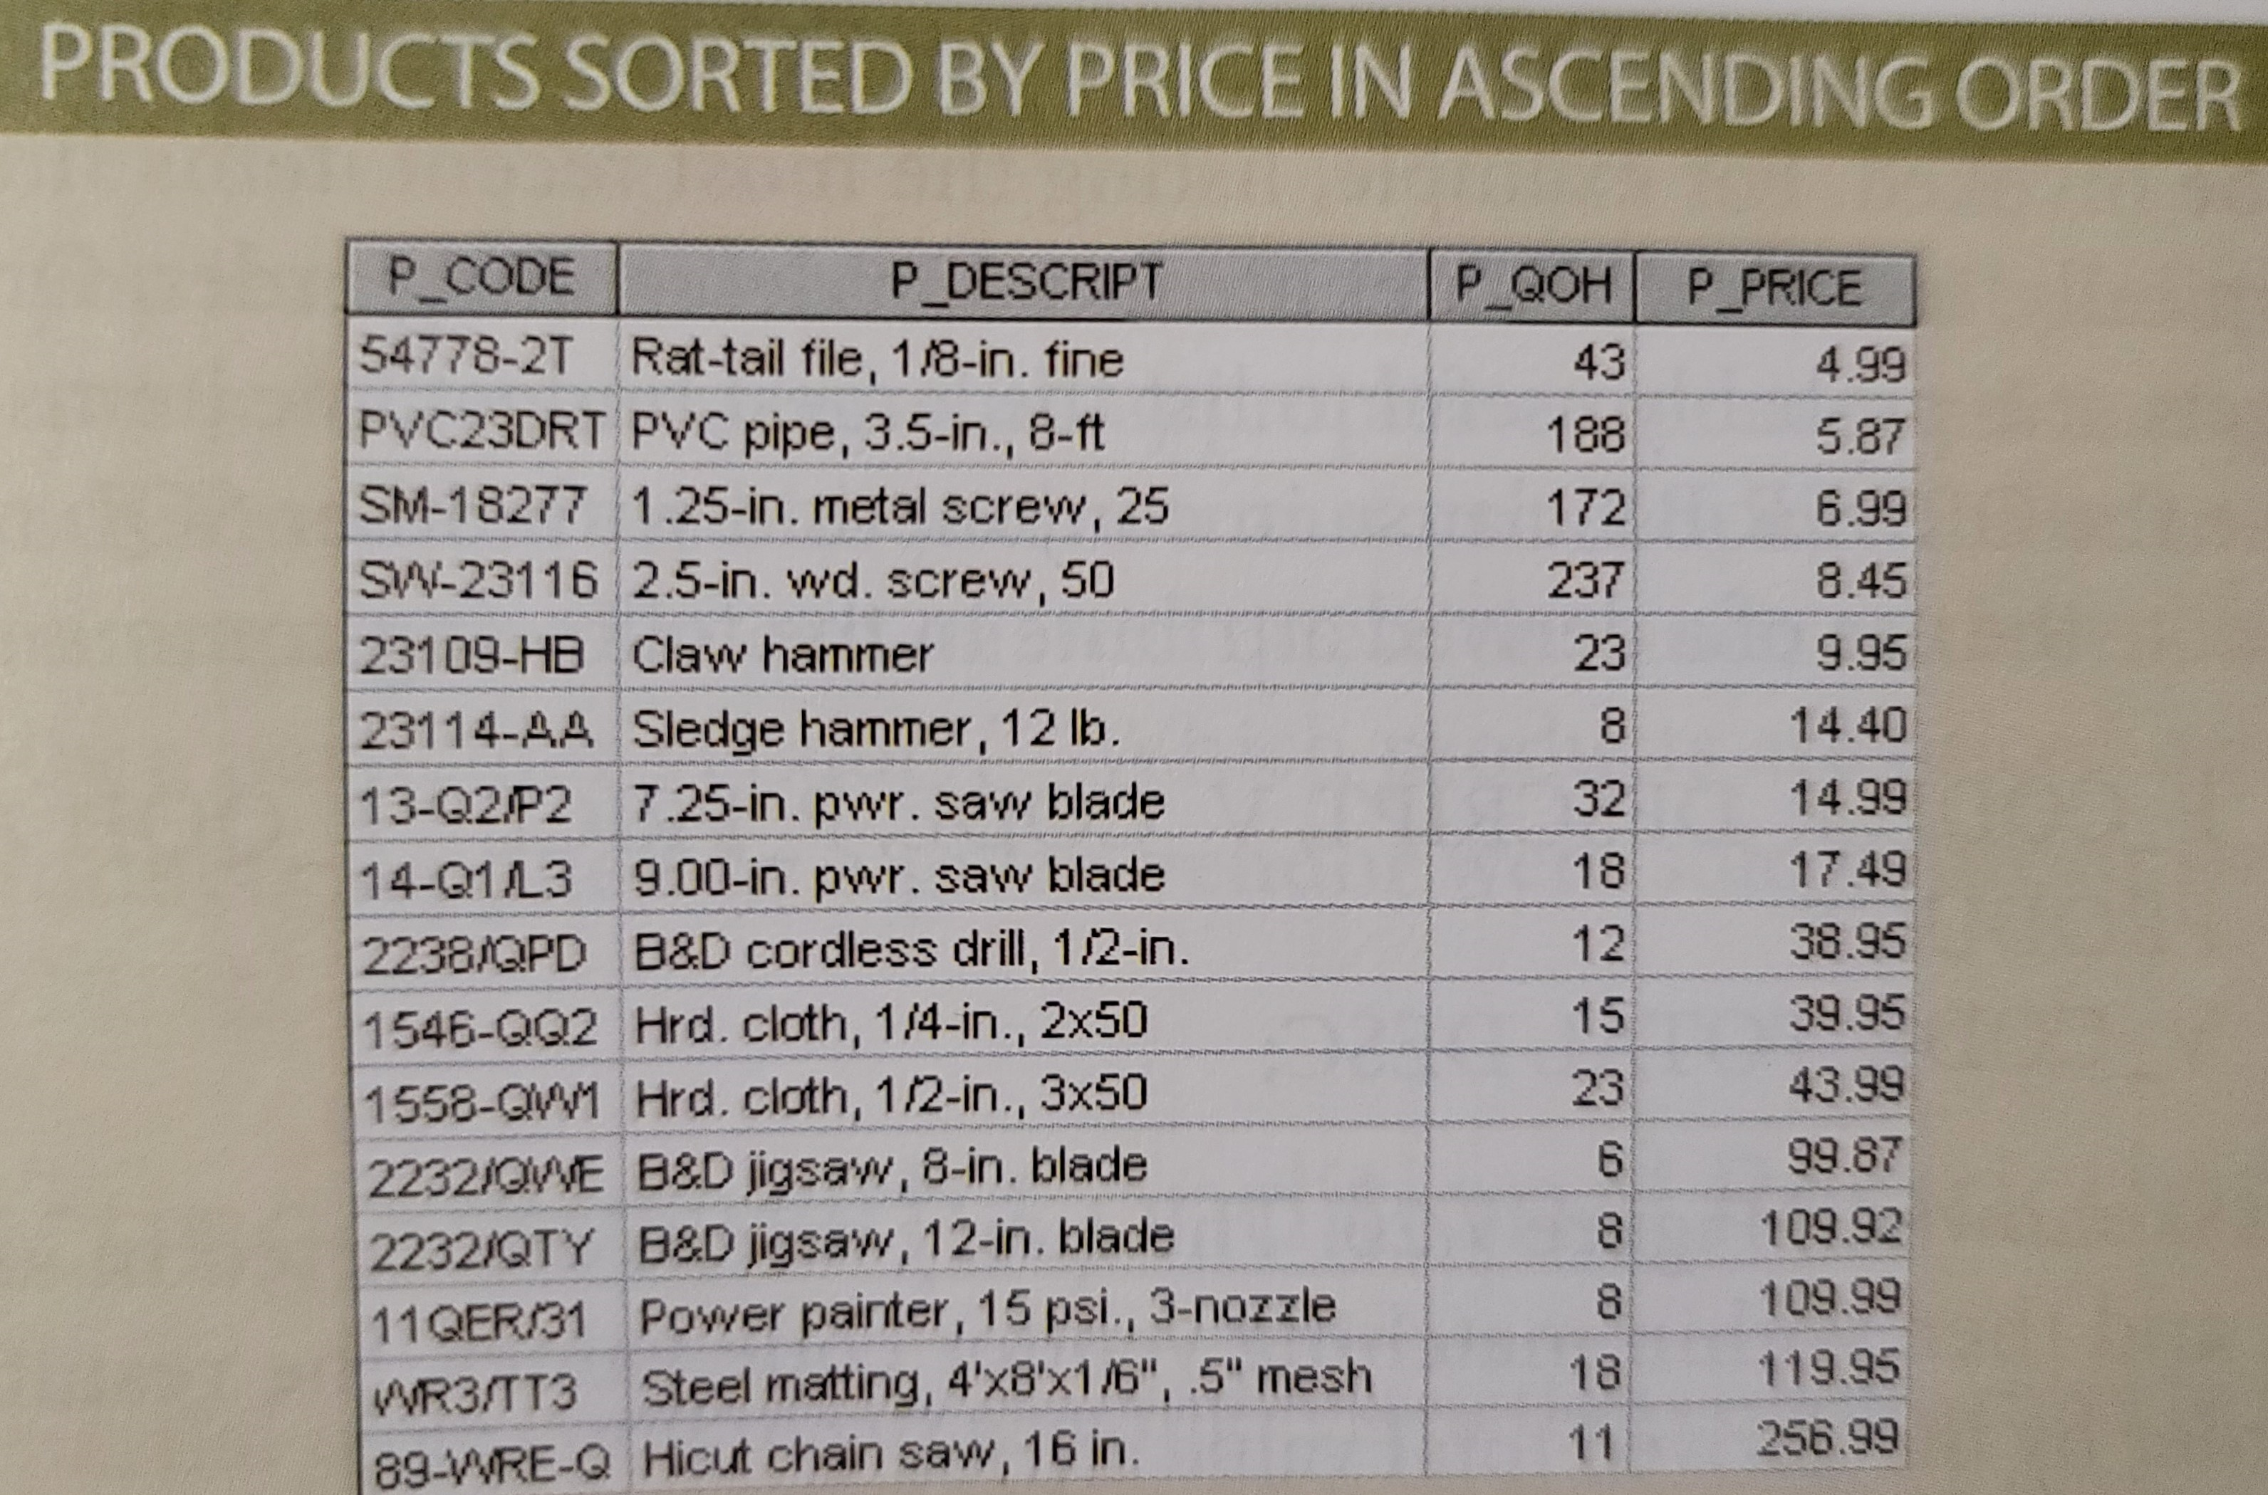
ORDER BY Clause Options
The ORDER BY Clause is especially useful when the listing order is important to us
Syntax: SELECT columnlist
FROM tablelist
[ORDER BY columnlist [ASC|DESC]];
NOTE: You have the option of declaring the order type-ascending or descending. (the default order is ascending).

Slide 7
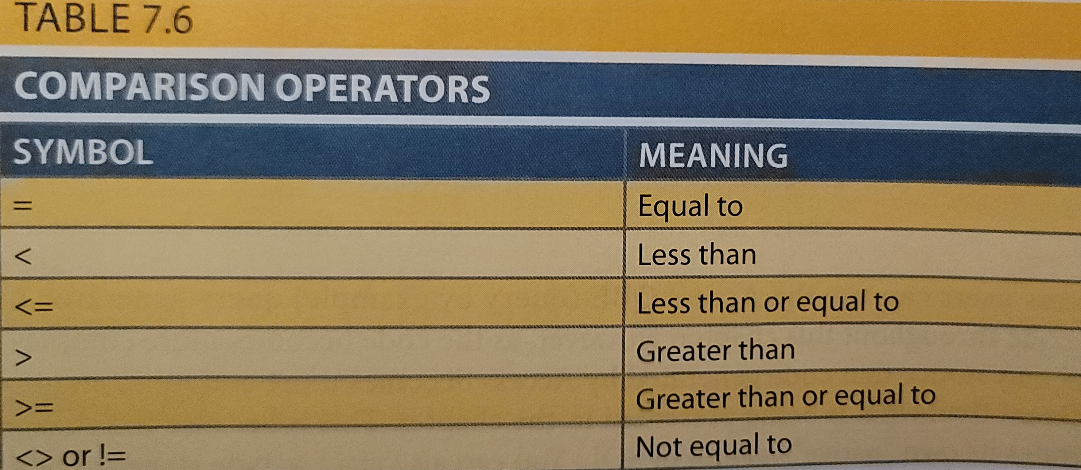
WHERE Clause Options
Using WHERE clause to add conditional restrictions to the SELECT statement that limit the rows returned by the query
Syntax: SELECT columnlist
FROM tablelist
[WHERE conditionlist]
[ORDER BY columnlist [ASC|DESC]];
Comparison Operators

Slide 8
Logical Operators
There are three Logical Operators;
AND
OR
NOT
These operators compare two conditions at a time to determine whether a row can be selected for the output.
When retrieving data using a SELECT statement, you can use logical operators in the WHERE clause, which allows you to combine more than one condition.
NOTE: The logical operator AND has the same SQL syntax requirement as OR.
NOTE; We can combine the logical OR with the logical AND to place further restrictions on the output.

Slide 9
Summary
SQL Joins Definition
Different types of Joins
Clause Options (ORDER BY, WHERE)
Logical Operators
CityU
of Seattle

Slide 10
Resources
Mukesh Negi, (2019): Fundamental of Database Management System
Coronel C., Morris S., (2019): Database Systems, Design, Implementation, & Management
Adham Saeed, (2017): Role of Database Management Systems in Supporting Information Technology
CityU
of Seattle

